Slide 1
World Most Deadly Disease
Burhan Rafid Ekatama

Slide 2
01
PROBLEM OVERVIEW
-----------------------------------------------------------------------------------------
02
DATA UNDERSTANDING
Content
-----------------------------------------------------------------------------------------
03
MODELLING AND RECOMMENDATION
-----------------------------------------------------------------------------------------
04
QUESTION AND SOCIETY INSIGHT
-----------------------------------------------------------------------------------------

Slide 3
Problem Overview
And
Data Understanding

Slide 4
Problem Overview
Heart disease describes a range of conditions that affect the heart. Heart diseases include Blood vessel disease, such as coronary artery disease, Irregular heartbeats (arrhythmias),
Based on cdc.gov, there are number of deaths for leading causes of death
Heart problems born with (congenital heart defects), Disease of the heart muscle, Heart valve disease
1. Heart Disease
2. Cancer
3. COVID - 19
4. Accidents
5. Stroke
6. Chronic Lower Respiratory Disease

Slide 5
Problem Overview
Total Respondents
70.000 person
Positive and Negative
Goals
Hope
35021 Person, Negative
34979 Person, Positive
Predict best model for patients who are suspected of having Heart Disease or not
Can reduce the risk of death from heart disease and can detect early from the symptoms of the disease

Slide 6
Data Understanding
13 Columns (id, age, gender, height, weight, ap_hi, ap_lo, cholesterol, gluc, smoke, alco, active, cardio)
70.000 Respondents
Encoding and deleting column “ID”
Columns Relabelling
13 Columns (Age, Height, Weight, Sys_Blood_Press, Dias_Blood_Press, Cholesterol, Glucose, Smoking, Alcoholic, Physical Activity, Cardio Diagnose, Gender_A_Female, Gender_A_Male)
Missing and duplicated value checking
Delete the row with unreasonable values

Slide 7
Modelling and Recommendation

Slide 8
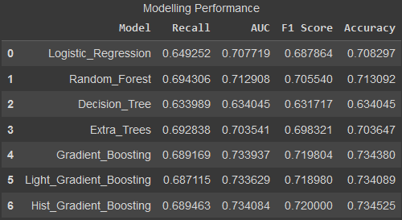

Modelling
Modelling Result
Based on tabel beside, it can be concluded that the best model is Hist Gradient Boosting
Highest Accuracy Value (0.7345)
Highest F1 Score Value (0.72)
The Recall value on Hist Gradient Boosting is 0.689, meaning that out of 100 person were tested, about 68 – 69 person get into Heart Disease

Slide 9
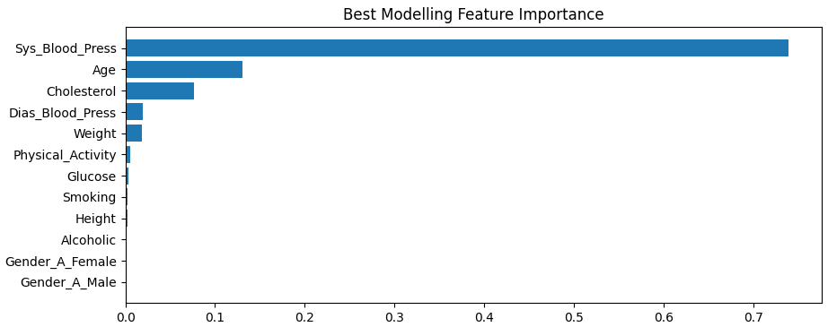
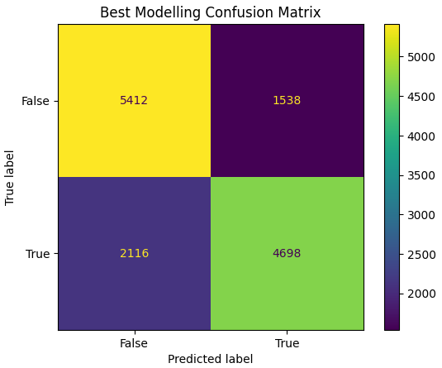
Modelling
Modelling Result
Based on tabel above, it can be concluded that the most common cause of heart disease is Systole Blood Pressure, Age, and Cholesterol rate

Slide 10
Question
And
Society Insight

Slide 11
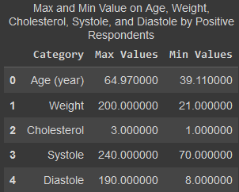
Some Questions
Question 1
From people with Heart Disease, how many on maximum and minimum point for the priority? So we can give more attention into it
From table beside, we know that all of positive respondent were in middle-aged, and a wide range of weight, Systole rate, and Diastole rate.
Everyone has the possibility of this disease

Slide 12
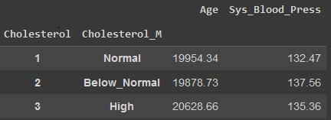
Some Questions
Question 2
Separated by cholesterol (most common cause of narrowing of the arteries), how mean of the Age and Systole?
From table beside, from all of positive Heart Disease respondents we know that on normal cholesterol rate, has the mean age is 19954,34 days (54+ years old) and mean Systole is 132.47. On high cholesterol rate, has the mean age is 20628.66 days (56+ years old) and mean Systole is 135.36
So we can conclude that person is 54 years old and above, with high Systole (standard value is 120) has a high risk of heart disease

Slide 13
Society
Insight
Heart disease describes a range of conditions that affect the heart. Heart diseases include:
Blood vessel disease, such as coronary artery disease
Irregular heartbeats (arrhythmias)
Heart problems you're born with (congenital heart defects)
Disease of the heart muscle
Heart valve disease
Many forms of heart disease can be prevented or treated with healthy lifestyle choices.
mayoclinic.org

Slide 14
Society
Insight
Coronary artery disease is a common heart condition that affects the major blood vessels that supply the heart muscle. Cholesterol deposits (plaques) in the heart arteries are usually the cause of coronary artery disease.
Symptoms of coronary artery disease can include chest pain, chest tightness, chest pressure and chest discomfort (angina), shortness of breath, pain in the throat, upper belly area or back, weakness or coldness in the legs or arms if the blood vessels in those body areas are narrowed
Risk factors for heart disease include:
Age, sex, family history, smoking, unhealthy diet, high blood pressure, high cholesterol, diabetes, obesity, lack of exercise, stress
mayoclinic.org

Slide 15
Society
Insight
There is some tips which you can use to prevention the heart disease
Don't smoke.
Eat a diet that's low in salt and saturated fat.
Exercise at least 30 minutes a day on most days of the week.
Maintain a healthy weight.
Reduce and manage stress.
Control high blood pressure, high cholesterol and diabetes.
Get good sleep. Adults should aim for 7 to 9 hours daily.
Based on the best model chosen, it is hoped that it can more quickly detect a person or patient who is suspected of having a Heart Disease. Because the faster the first treatment of a patient can increase the percentage of recovery from that patient.
mayoclinic.org

Slide 16
References
https://www.cdc.gov/nchs/fastats/leading-causes-of-death.html
https://www.mayoclinic.org/diseases-conditions/heart-disease/symptoms-causes/syc-20353118

Slide 17
THANK YOU
Reach me anytime:
Project link:

